Slide 1

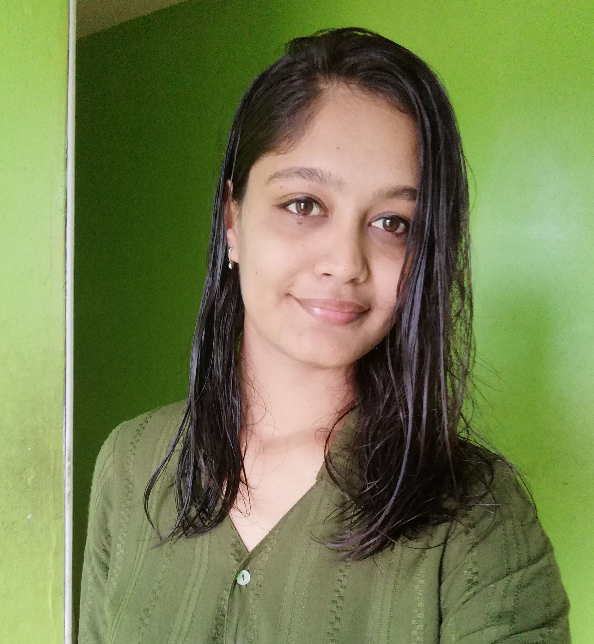

Experience
Areas of expertise
Data Engineer( Apr 2021 - Present)
Internship: Azure Fundamentals, Power BI and Power Apps learning paths.
Developing mobile apps using Power Apps and Power BI for visualization
Functional
Mobile App development using Power Apps
Analytical abilities
Testing abilities
Agile./Design thinking
UI/UX
Industries
Telecommunications
Technical
Web (HTML/CSS/JS/TS/PHP)
SQL(SSMS)
Java
Angular
React
Spring
AWS
Python
Tosca
GIT
Docker
Azure services (Azure SQL)
Power BI
Power Apps
Azure Data Factory
Education
Yashna CHINTA
MSc Applied Software Technologies
University of Mauritius, 2020-2021
BEng(Hons) Electronic and Communication Engineering
University of Mauritius, 2015-2019
Data Engineer
Application Development Associate Ebène, Mauritius.
Professional background
Certifications
Electronic and Communication Engineering graduate with 1 year of experience in telecommunication Engineering
I love code deciphering
AZ-900 Azure Fundamentals
Cisco Certified Network Associate Routing and Switching (CCNA)
Jan 2020 – Jan 2023
HCIA-Routing & Switching
Jan 2020 – Jan 2023

Slide 2

Current Experience
Data Engineer Intern
Skills & Technologies
I am responsible for the following activities:
Self learning
Azure Fundamentals
Azure Data factory and Azure Synapse
Power BI
Power Apps
Assignment Project
Title: Design a mobile app to improve patient care using Power Apps (WIP)
Skills
Teamwork
Problem Solving
Creative Thinking
Troubleshooting skills
Fast learner
Technical
Azure SQL
SQL Server Management Studio
Power BI
Power Apps

Slide 3
Past Experience
Wireless Engineer Intern – Huawei Technologies Jun 2019 – Jun 2020
Selected for the Huawei Seeds of the Future 2019 Program for 2 weeks training program in China
Training: Chinese culture & language and 4G&5G network, AI
Part of wireless projects in Service and Delivery Department for 4G and 5G deployment
Worked in safe City Project: Reporting weekly network health check KPI Reports (skills in Excel use of VLOOKUP, pivot chart), Drive test to check networks, worked with different dispatching systems, troubleshooting network issues, Camera configurations and integration into system
Intern - Industrial Training May 2012 – Jul 2012
Mobile Department: 2G, 3G and 4G cellular Network
Fixed Switching: Call flow and signaling of PLMN networks
Transmission Department: GPON, fiber optics
Earth Station: Antennas and satellite communication
Power Unit and the systems

